Slide 1
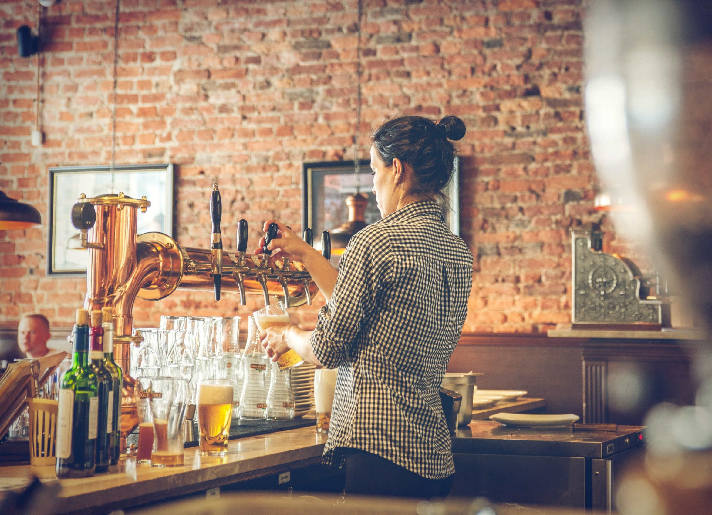
Craft Beer
Analysis
Michael Catalano Hayley Horn
Notes:
Beer can be made using a range of ingredients to adjust the color, type and flavor profile. This analysis focuses on two measurements of beer composition, and some geographic details. The first measurement is Alcohol By Volume (ABV) which is a percentage that represents how much of a beer is alcohol versus other ingredients. The other measurment we will consider is International Business Units (IBU) which is measured on a scale of 0 to 100 and describes the bitterness from hops in a beer.

Slide 2
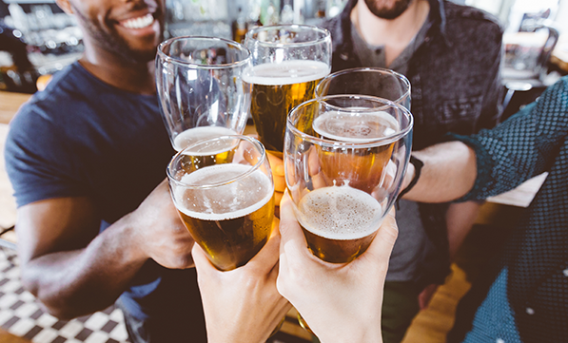
The Big Idea
Share regional preferences around bitterness and alcohol content
Scope of Analysis
Craft breweries within each state and region
Geographical preference for alcohol content and bitterness (IBUs)
Relationship between the bitterness of the beer and its alcoholic content
Findings
Bitterness of the beer and its alcoholic content don’t always correlate
The state doesn't always determine IBU or ABV percentage – must look at regions
States with low brewery counts can skew the results (West Virginia)
57 percent of Millennials drink craft beer every week in the United States*
*Survey by The Futures Company for the Brewers Association 2016

Slide 3
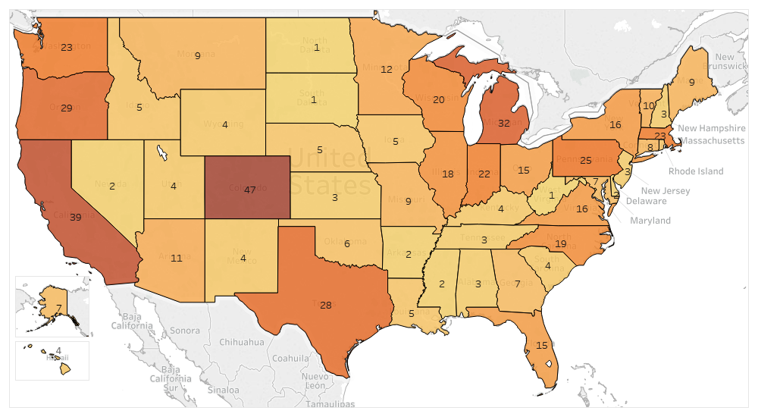
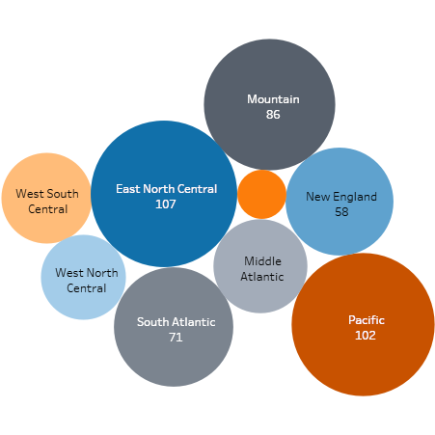
Craft Beer
Breweries by State
3
There is a great amount of variablility in number of breweries by state. California and Colorado are the states with the most breweries
At a region level, the East North Central region (Great Lakes) has the highest concentration of breweries, followed by the Pacific region
Notes:
Colorado with 47, and California with 39. You can also see a bubble chart by region, and the amount of breweries within. We can see the East North Central region (Great Lakes states) have the highest numbe of breweries, followed by the Pacific, and Mountain regions.

Slide 4
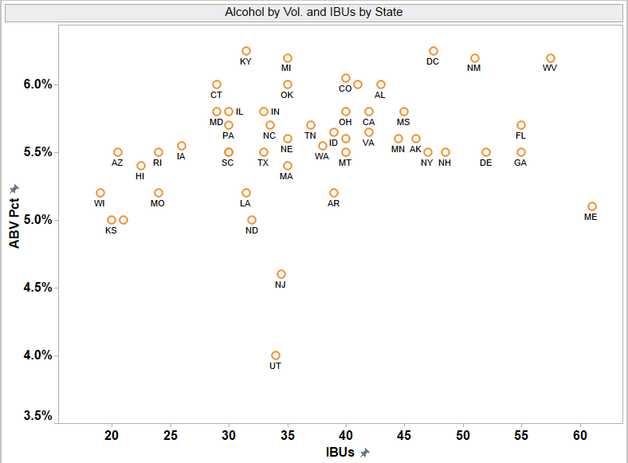
Alcohol Content and Bitterness
Scatter Plot by State
4
A
Midwest states like Wisconsin, Kansas, Arizona, Missouri, and Iowa have a lower IBU rating, and lower ABV. Hawaii also has a low IBU rating
D
C
B
East coast states like Maine, West Virginia, Florida, Georgia, Delaware, and have higher IBU ratings
B
A
C
States with lower numbers of breweries may skew the data, or give us other insights (high IBUs don’t necessarily correlate with high ABV in Maine)
R² = 0.079
D
States with larger number of breweries are found in the middle-range of ABV and IBUs
Notes:
The scatterplot is usually the first step we’ll take when determining a relationship between two variables, in our case we want to understand if theres a relationship between ABV and IBU, and how that looks at a state-level. From an initial look, without even looking at states, there doesn’t appear to be much of a relationship, kind of looks like a cloud with these data points, no real trend either positive or negative to see. The study showed very little correlation between ABV and IBUs. Only 8% of the variance of IBUs can be explained by ABV, which isnt all that high (more in the appendix if interested). We’ll cover correlation
now lets focus on the states themselves. (read bulleted list)

Slide 5
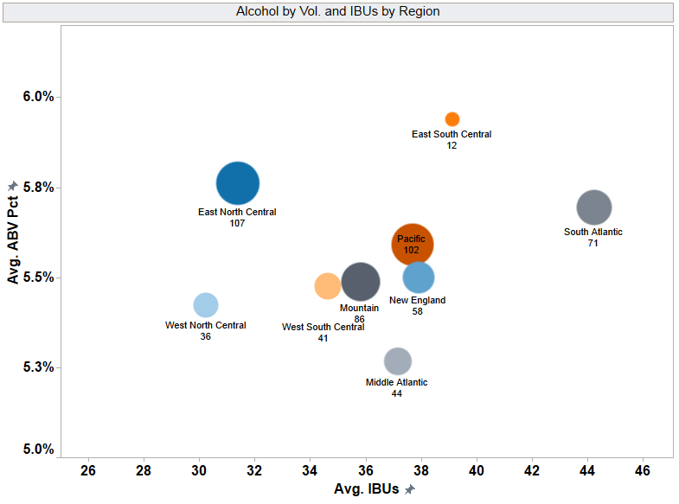
Alcohol Content and Bitterness
Scatter Plot by Region
5
South Atlantic region is “hoppier” using avg. IBUs (44.3 IBUs)
East South Central region has the highest average ABV (5.9%), but the lowest number of breweries (12)
Middle Atlantic region has the lowest ABV (5.3%), and is midrange in IBU rating (37 IBUs)

Slide 6
APPENDIX
6

Slide 7
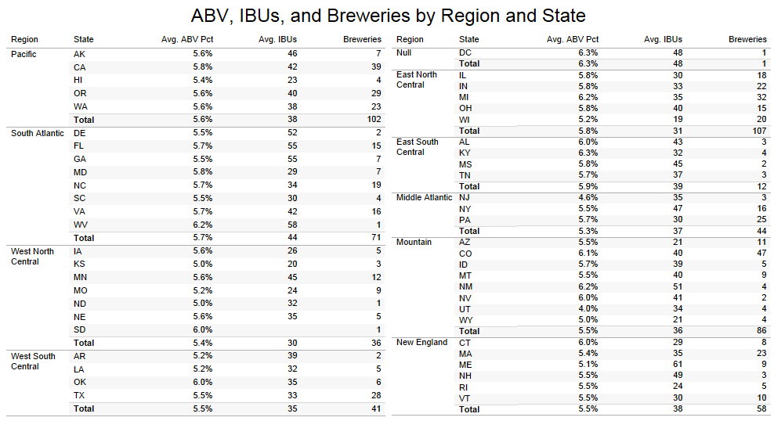
Data Snapshot
7
Notes:
If we need a different slide, here is an alternate format

Slide 8
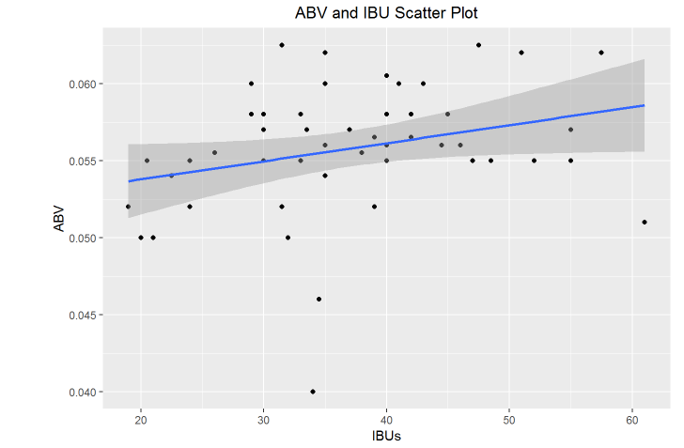
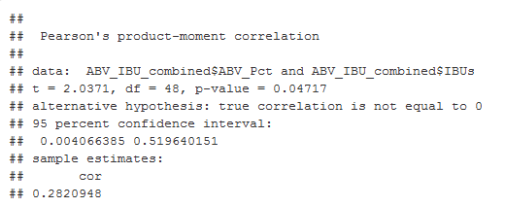
Correlation Analysis
8
The study showed very little correlation (r = 0.282, p-value = 0.0471) between ABV and IBUs using scatter plot and Pearson’s Product correlation formula. Only 8% of the variance of IBUs can be explained by ABV.
Notes:
If we need a different slide, here is an alternate format

Slide 9
Further Research
8
Share of weekly craft beer drinkers in the United States in 2015, by generation
U.S. weekly craft beer drinkers 2015, by generation
Note: United States; 2015; 21 years and older; >10,000; U.S. consumers*
Further information regarding this statistic can be found on page 8.
Source(s): Brewers Association; The Futures Company; ID 289529
2

